Slide 1

GROCERY INVENTORY MANAGEMENT SYSTEM
Ashokkumar Sharma
Shivani Kulkarni

Slide 2
BACKGROUND
Focuses on in-store management of products.
Eases cumbersome tasks like restocking, keeping a track of items available and items that need to be discarded
Store Manager is the user of this system.
Helps the store manager in ordering products from vendors, the product to be ordered, its quantity and the time when it should be ordered.

Slide 3
TOOLS USED
SQL Server Management Studio – For backend (SQL Scripting)
Microsoft Access – For frontend development (Creating UI and Forms)
Microsoft Visio – For Entity Relationship Diagram

Slide 4
ASSUMPTIONS
The threshold calculated is based on the sale of previous one month.
The restocking of products take 5 days.
The user of the system is a non-technical person
For every product, there are different product instances based on their Sell-by-date.

Slide 5
ENTITIES
Store Manager
Vendor
Product
Product Instance
Sales Order
Sales Orderline
Purchase Order
Restock Orderline

Slide 6
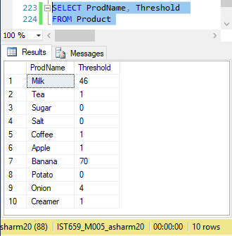
MAJOR DATA QUESTIONS
How often is the product being restocked?

Slide 7
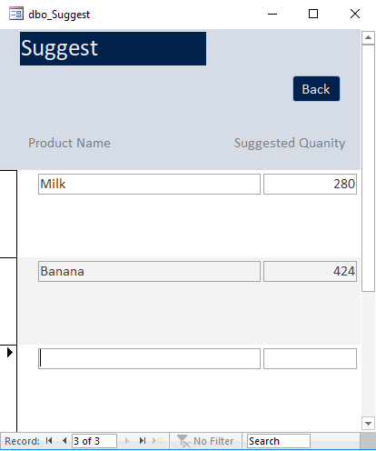
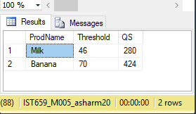
MAJOR DATA QUESTIONS
Which product needs to be restocked? In what quantity?

Slide 8
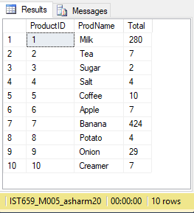
MAJOR DATA QUESTIONS
What products are sold most popularly?

Slide 9
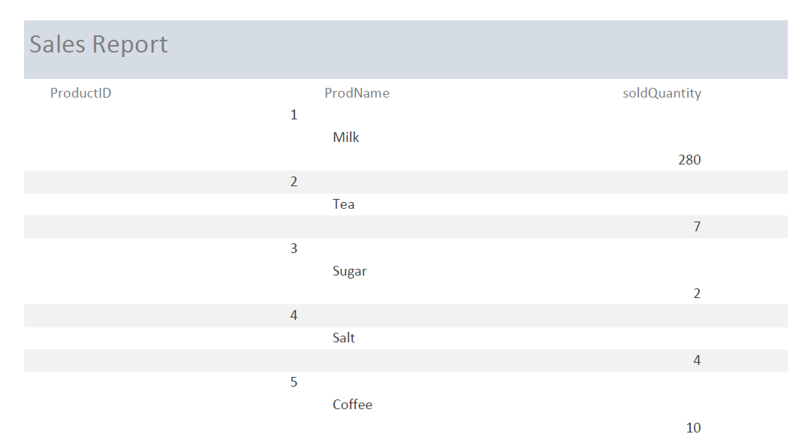
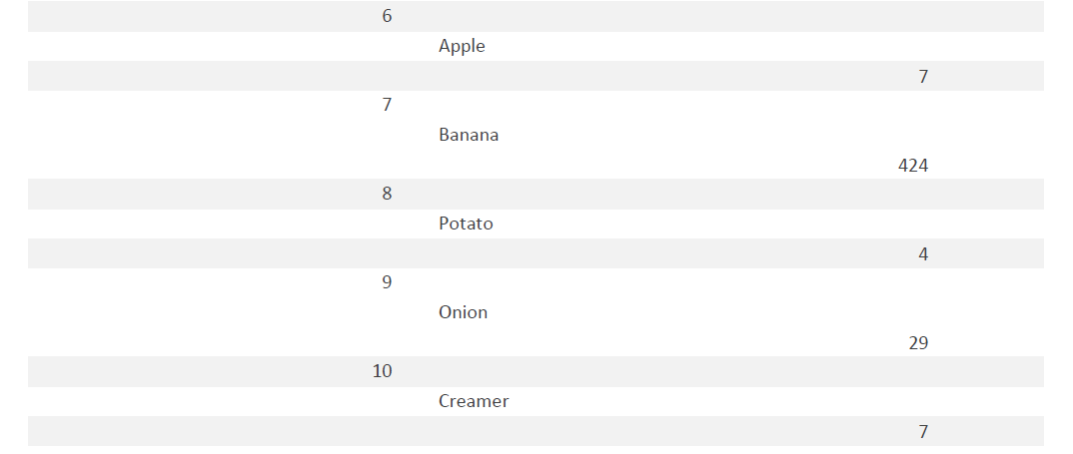

Slide 10
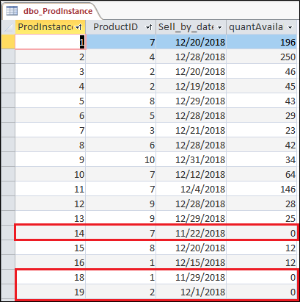
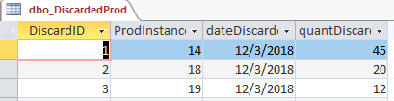
MAJOR DATA QUESTIONS
How to determine what product must be discarded?

Slide 11
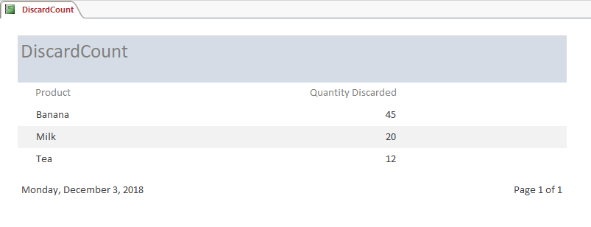
MAJOR DATA QUESTIONS
How many products are discarded and in what quantity?

Slide 12
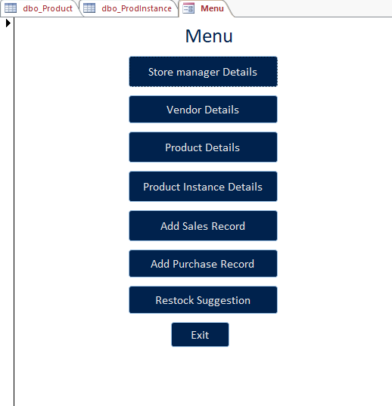
INTERFACES
Main Menu

Slide 13
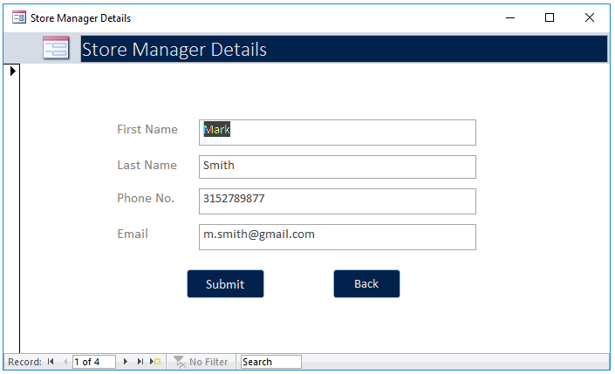
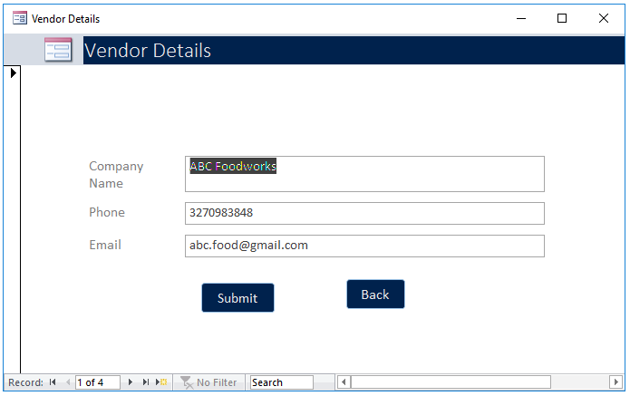
Store Manager Details
Vendor Details

Slide 14
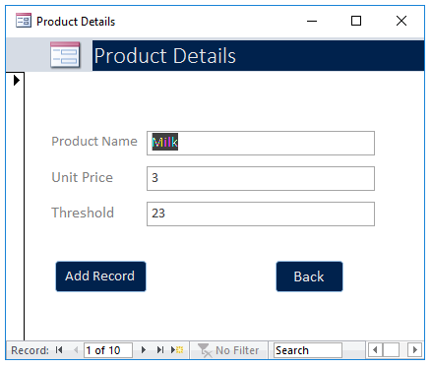
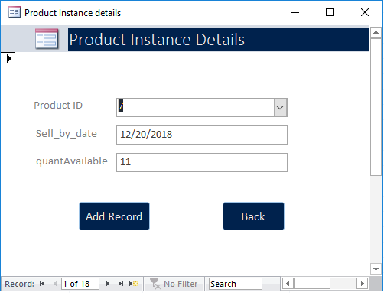
Product Details
Product Instance Details

Slide 15
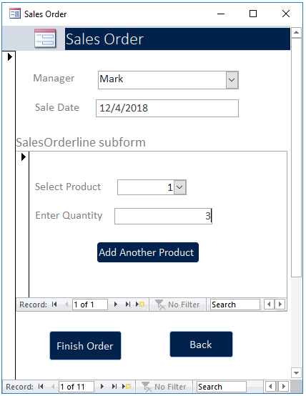
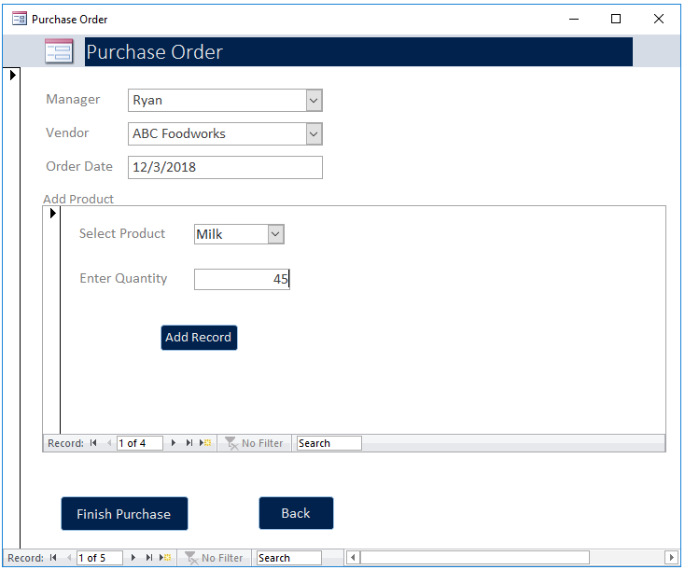
Purchase Order
Sales Order

Slide 16
THANK YOU

